Slide 1
2018 CNL_ICL Customers CRD Summary Report
Prepared by:
Harry Yu, SA Moy, Jagadeesh, Dan Burkholder

Slide 2
Objectives
Share Findings from CMEE Mobile Industry Data Collection (CNL/ICL platform customer survey)
    Summarize data collected from the Mobile Customers manufacturers:
      Inventec CQ
      Compal CQ
      Quanta CQ/SH
      LCFC
      Compal KS
      MSFT/JDM1
      Pegatron SZ -> Just learned (Jan ’18) they are shutting down the BU that the CMEE team works with
      Wistron KS
      MSI KS
      Pegatron CQ (ICL ORS)
      Foxconn WH (ICL ORS)
      Huaqin (ICL ORS)
Apple not included
ORS=ODM Reference System

Slide 3
PCB Vendor

Slide 4
PCB vendors that ODMs are using
 | TMT T-Mac Techvest PCB Co. Ltd* | ChuanYi = Under GBM** | Tripod | AT&S | Wus | UMT | Compeq | Hannstar | GCE | Unitech | ZDT
Inventec CQ |  |  | x |  |  |  |  | x | x |  | x
Quanta CQ | x |  | x |  |  |  |  |  | x
Quanta SH | x |  | x |  |  |  |  |  | x
Compal CQ | x | x
Compal KS |  |  |  |  |  |  |  |  | x
Wistron KS |  |  | x | x | x | x | x
LCFC |  |  | x |  |  | x |  | x
Pegatron SZ |  |  | x |  |  |  | x | x | x
MSFT/JDM1
MSI KS |  |  | x |  |  |  |  | x |  | x
Foxconn WH |  |  |  |  |  |  |  | x |  |  | x
ODMs have a wide PCB supply base
Tripod, GCE and Hannstar looks more popular than others. AT&S and Nanya are seldom used by client ODMs.
Other information:
Most factory engineers prefer HIMB instead of RIMB due to lake of experience of RIMB
Customer sees 30%~50% cost up shift from type 3 to type 4 (HDI) PCB
Most customer prefer 8L (2-4-2) PCB due to cost efficiency
Factory people prefer to keep board thickness 0.8~1.0mm range, but see some OEM design trend to ~0.6mm (typically “boutique designs” on the –Y series, not mainstream. Typical roadblocks; plane inductance / impedance)
Almost all customers use OSP; Microsoft uses ENIG for critical BGA locations
* TMT Website-> http://www.tmt-pcb.com.tw
** GBM Website -> http://www.gbm.com.tw/en/business/chuan-yi.html

Slide 5
SOLDER PASTE PRINT

Slide 6
Board support mechanism
Support Pins | Support block | Vacuum block | Print pallet (Whole process pallet. Print -> Reflow.)
Inventec CQ | Inventec CQ | Quanta CQ | Pegatron SZ
Compal KS | Compal CQ |  | MSFT/JDM1
MSI KS | Compal KS
Foxconn WH | Wistron KS
 | Pegatron SZ
 | MSFT/JDM1
 | MSI KS
4 Customers | 7 Customers | 1 Customer | 2 Customers
Most customers use support Pins for NPI project and a Support block for HVM project
Quanta CQ use their own developed vacuum block
Pegatron is one customer that we know often prefers to use a whole process (print-> reflow). Their rule, if <0.85mm (33 mils) board thickness, must use whole process pallet
MSFT/JDM1 uses a Support block + Whole process pallet at same time

Slide 7
Misprint board cleaning
Offline machine clean |  | Manual clean
Inventec CQ | Quanta SH | Pegatron SZ (OSP only) | MSFT/JDM1 (OPS only)
Compal KS | Foxconn WH | Pegatron CQ
Compal CQ
Wistron KS
Pegatron SZ (SF except OSP)
MSFT/JDM1 (SF except OSP)
Quanta CQ
Most customers have an offline machine to clean misprint boards
Pegatron SZ and JDM1 use a manual board clean process for OSP boards, due to the worry of impact of solvents to OSP board surface finish

Slide 8
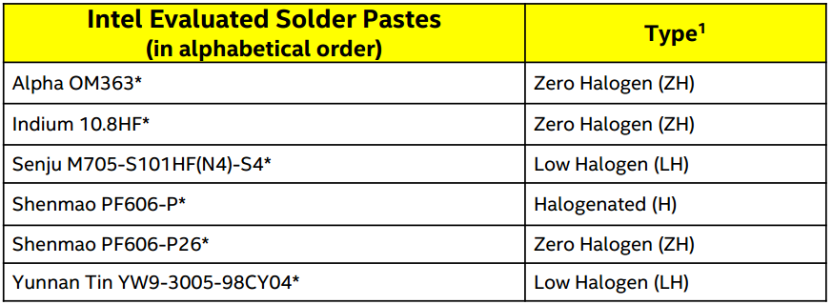
SAC Solder Paste Formulation (Brand and Model)
Shenmao (PF606-P) | Senju (Various Formulations) | Yunnan Tin/Eunow (YW9-3005-98CY04 ) | Other Solder Paste
Compal Plant 4 (Asus & Lenovo) | Compal Plant 4 (Senju M705-S101HF(NL3)-S4 | Compal Plant 2 (HP) | Inventec CQ (Tamura TLF-204-93 IVT)
Inventec CQ | Pegatron Suzhou Plant 6 (JDM1/MSFT) (Senju M705-S101HF(N4)-S5 Type 5) | Compal Plant 3 (Dell) | MSI KS (KOKI S3X58-M406)
Quanta CQ/SH | Wistron (Senju M705-S101ZH-S4(W2) |  | Foxconn WH (Loctite HF108)
Pegatron Suzhou | LCFC (Senju M705-XXX-S4) *AND* (LTS paste on next page)
Compal Plant 3 (Dell) | MSI (Senju M705-S101ZH-S4(W2)
Shenmao PF606-P is still widely used by many TW ODMs
Senju is also widely used in the industry
Compal is using Yunnan Tin/Eunow across different plants (No change from last survey)
  Recent request was made in the PTR to remove YT solder paste from the MAS
Microsoft (JDM1) is switching their factories away from Indium, over to Senju (they claim that Shenmao doesn’t print well)
Other information:
Most customers are not ready/not in progress switch to type 5 paste (except for Microsoft, using Type 5)
Mobile/Client
MAS:

Slide 9
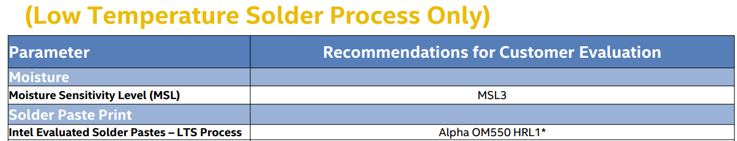
LTS Solder Paste Formulation (Brand and Model)
Alpha OM550L-HRL2 | Senju L28-143HF (L) |  | Others
LCFC (First Source LTS Paste) | LCFC (Second Source LTS Paste)
LCFC is the only customer that we are aware is using LTS in HVM (mobile/client)
Cannon Lake MAS:

Slide 10
Stencil Thickness, mfg process, stencil vendor and minimum AR
Customer | Stencil Thickness for Y and U | Stencil mfg process | Stencil Vendor | Min AR
Inventec CQ | 0.1mm | Laser Cut + fine grain & nano coat | Fosen & Sunshine | 0.66
Quanta CQ | >=0.08mm | Laser Cut | Fosen & Sunshine | 0.66
Quanta SH | >=0.08mm | Laser Cut | Fosen & Sunshine | 0.66
Compal CQ | Follow Intel MAS | Laser Cut | Fosen | 0.66
Compal KS | Prefer 0.1mm | Laser Cut | Internal Lab | 0.66
Wistron KS | Follow Intel MAS | Laser Cut | Forsen & Sunshine | 0.6
LCFC | 0.13mm(U), 0.1mm(Y) | Laser Cut + fine grain | 美微科技 | 0.66
Pegatron SZ | 0.08mm-0.1mm | Laser Cut + nano coat | Sunshine | 0.66
MSFT/JDM1 | 0.1mm | Laser cut or E-form (for Y) + nano coat | Desco (DEK) | 0.58
MSI KS | 0.1mm-0.13mm | Laser Cut | Zhuo Li Da&Yun Sheng Ji | 0.66
Pegatron CQ | 0.08mm | Laser Cut | Sunshine | 0.71
Foxconn WH | 0.12mm | Laser Cut and electro polishing | Internal Lab | 0.66
Most customer still prefer 3mil stencil thickness for -Y, and 4/5mil stencil thickness for -U
Thinner stencil will cause insufficient past on other components (connectors)
Laser cut is still the mainstream, fine grain and nano coat also being used
Fosen and Sunshine are the major stencil suppliers in PRC
Most customer still maintain a 0.66 min Area Ration (AR), but Wistron & Microsoft can achieve lower AR
Mobile/Client MAS: -H & -U Series (4 & 5 mil), -Y Series (3 & 4 mil)
Notes:
FYI: Conversions: 0.08=3 mil, 0.1=4 mil, 0.12/0.13=5 mil, 0.15=6 mil

Slide 11
PNP

Slide 12
Pitch, Ball size and Vision system
Customer | Minimum ball pitch experienced | Minimum ball pitch PnP machine can recognize | Minimum ball size PnP machine can recognize
Inventec CQ | 0.4mm | 0.35 mm (Panasonic NPM) | 8mil
Quanta CQ | 0.4mm | 0.4mm | 8mil
Quanta SH | 0.4mm | 0.4mm | 8mil
Compal CQ | 0.4mm | 0.4mm (Panasonic CM602) | 9mil
Compal KS | 0.4mm | 0.4mm | 9mil (Panasonic NPM)
Wistron KS | 0.35mm | 0.4mm | 10mil
LCFC | 0.4mm | 0.4mm
Pegatron SZ | 0.35mm | 0.3mm (Panasonic), 0.4mm (Fuji) | 7mil (Panasonic), 10mil (Fuji)
MSFT/JDM1 | 0.35mm | 0.35mm | 8mil
MSI KS | 0.4mm | 0.4mm, 0.15mm (offline camera) | 10mil, 3.5mil (offline camera)
Pegatron CQ | 0.4mm | 0.35mm | 10mil
Foxconn WH | 0.4mm | 0.4mm | 8mil
0.4mm pitch still the main stream of the lowest ball pitch
< 0.4 mm ball pitch is still challenging for most ODM customers
  Apple’s expectation: HT package warpage must be held <60um for <0.4mm pitch
  Also, FYI, square packages (with tighter pitches) are easier to manufacturer than rectangular packages
Some customer have 0.35mm pitch experience on small BGAs (<8x8mm)

Slide 13
SPI

Slide 14
SPI brand/model#, camera resolution and volume up/low limit
Customer | SPI brand/model# | Camera resolution (x um/pixel) | Paste Volume Upper/Lower limit (from theoretical paste volume)
Inventec CQ | TRI 7007 SII KY 8038-3 | TRI: 15um KY: 12um | -40% to +60%
Quanta CQ | Cyber Optic SE500 | 30um | -50% to +50%
Quanta SH | Saki XXX, Cyber Optic SE500 | 30um | -50% to +50%
Compal CQ | Cyber Optic SE500 | 15um | -45% to +45%
Compal KS | Cyber Optic SE500 |  | -40% to +60%
Wistron KS | KY 8030-3 | 23.5um | -60% to +70%
LCFC | KY 8038-3XDL | 12.5um | -55% to +70%
Pegatron SZ | TRI 7007 KY 8030L | 15um | -50% to +50%
MSFT/JDM1 | KY 8030L | 15um | -50% to +50%
MSI KS | TRI 7007i SII plus | 15um | -50% to +60%
Pegatron CQ | TRI 7006 KY 2NB/3/L | 15-25um | -50% to +50%
Foxconn WH | KY 8030L/8030L-2 | 15&23.5um | -40% to +60%
KY, TRI and Cyber Optic are the most common brands
Paste volume limits vary across ODMs
Customers screen by global BGA package limits (CPTD screens by each pad)
CPTD Setting is -50% to +50% from Theoretical Paste Volume

Slide 15
REFLOW

Slide 16
Reflow Belt Speed, Reflow Pallet Clearance
Customer | Belt Speed | Reflow pallet clearance (space for thermal expansion during reflow)
Inventec CQ | 1250 mm/min | 1 mm
Quanta CQ | 1350~1400 mm/min | <0.5 mm
Quanta SH | 1100~1200 mm/min | <0.5 mm
Compal CQ | 1050~1100 mm/min | 2 mm
Compal KS | 1500 mm/min | 1 mm
Wistron KS | 1300~1500 mm/min | 1 mm
LCFC | 1200~1500 mm/min | 0.5 mm
Pegatron SZ | 1200 mm/min | 0.5 mm/each side, 1 mm total
MSFT/JDM1 | 900~1200 mm/min | 3 side 0.4 mm, 1 side 1 mm, tooling pin only at one side
MSI KS | 900 mm/min | 2 dowel pins are used to hold the board (0.15 mm clearance from pins)
Pegatron CQ | 1000~1500 mm/min
Foxconn WH | 850~950 mm/min
Most customer belt speed >1000mm/min, some reach to 1500mm/min
Typical reflow pallet clearance ~0.5mm up to 2mm
CPTD Setting: *1mm (min) clearance from all board edges [for 1000mm or less boards]

Slide 17
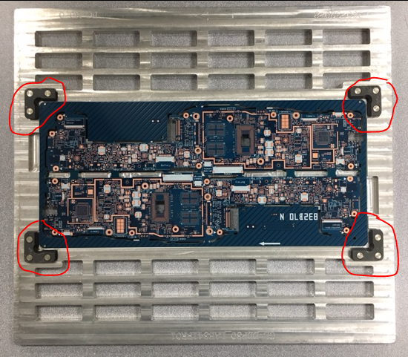
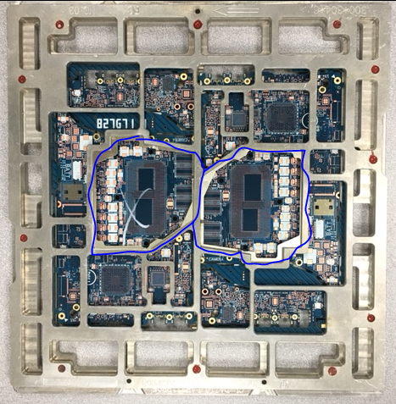
Reflow Pallet Design – Compal KS (Example Case)
New Automated Board Placement Into Reflow Pallets
    Compal has introduced a new automatic board handling flow.
    Before reflow, a machine will pick up the board and put it into the reflow pallet.
    The 4 raised edges (circled) act as a guide - even if there is an offset by the pickup machine, the board will still sit correctly into the pallet.
Board Hold Down Usage Methodology
    Since Compal started using automated handling, they cannot use clamps or Kapton tape for board hold down.
    Their current rule is if the board has EMI fences/shields, they will use a top hat cover to hold down the shields (circled).
    If there is no shield, they will use a pallet w/o clamps or tape.

Slide 18
Yield Target

Slide 19
BGA yield target
Customer | Intel BGA SMT yield target | Intel BGA rework yield target
Inventec CQ | 600 DPM | 92%-95%
Quanta CQ | 2500-3000 DPM (Whole MB) | 85%-90%
Quanta SH | 2500-3000 DPM (Whole MB) | 85%-90%
Compal CQ | 1000 DPM | 96%
Compal KS (Plant 3 / Dell) | 1000 DPM | 95%
Compal KS (Plant 4 / Lenovo) | 300 DPM | 95%
Wistron KS | 5000 DPM (Whole MB) | 95%
LCFC | N/A. | Rework With corner underfill: 85% Rework Without corner underfill: 92%
Pegatron SZ | 5000 DPM (Whole MB) | 90%
MSFT/JDM1 | 500 DPM | 95%
MSI KS | 1000 DPM | 95%
Pegatron CQ | 5000 DPM (Whole MB) | 90%
Foxconn WH | 5000 DPM (Whole MB) | 98%
Customer SMT & Rework yield expectations are high for BGAs:
  SMT Yield expectations between 300-1000 DPM for Intel BGA or 2500-5000 for whole MB, depending on the ODM
  Rework Yield expectations between 85-98%, depending on the ODM
CPTD Setting: SMT & Rework Validation (At PRQ) = 99.5% @ 90% CL

Slide 20
Rework

Slide 21
Rework Process (flux material used for flux-only rework)
Customer | Flux-Only Material | Comments
Inventec CQ | Shenmao SMF-2
Quanta CQ | Shenmao (???)
Quanta SH | Shenmao (???)
Compal CQ | AIM solder paste flux NC254
Compal KS | AIM solder paste flux NC254
Wistron KS | Shenmao SMF-2
LCFC | N/A | SAC305 paste on board, not using flux only rework
Pegatron SZ | PASTE FLUX 7LV (Alpha) | Most rework process use paste
MSFT/JDM1 | Need match the printing solder paste (paste flux)
MSI KS | Yi Cheng Da, Model:RW-3 | For Intel BGA, always use paste print on board
Pegatron CQ | N/A (Customer didn’t answer)
Foxconn WH | Henkel HF108RWF or Vital LF4000
For -Y package (with 0.43mm pitch), to print paste onto the PCB with a mini-stencil is very challenging, customers have to use a flux-only rework process
However, a flux-only rework process may not be suitable for LTS rework process
CPTD Setting: Alpha PoP 707 flux
The Flux-only Material is not Mentioned in the MAS

Slide 22
Adhesive

Slide 23
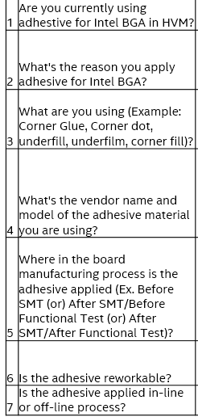
Adhesive on Intel BGA
Adhesive questions that were recently asked during Cannon Lake Platform Introduction, in 2017:
Previously we had not been asking customers about adhesive usage

Slide 24
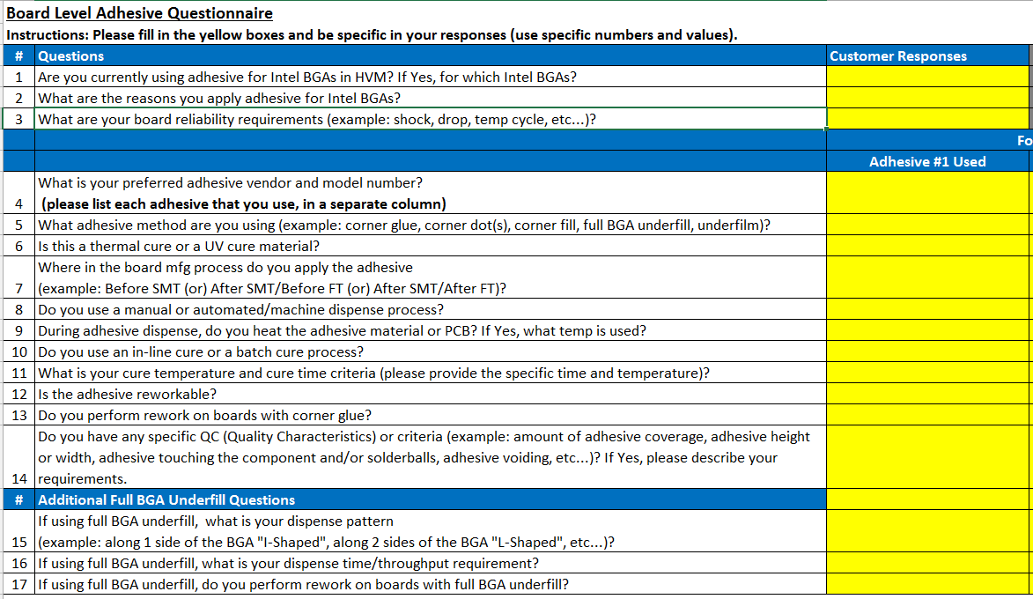
Adhesive on Intel BGA
Updated adhesive questions to be asked (Jan 2018) for a deeper understanding of adhesive usage across the ODM customer base:

Slide 25
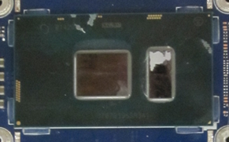
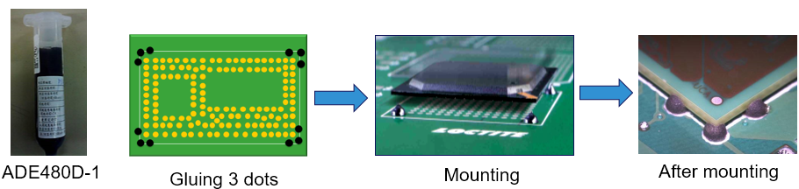
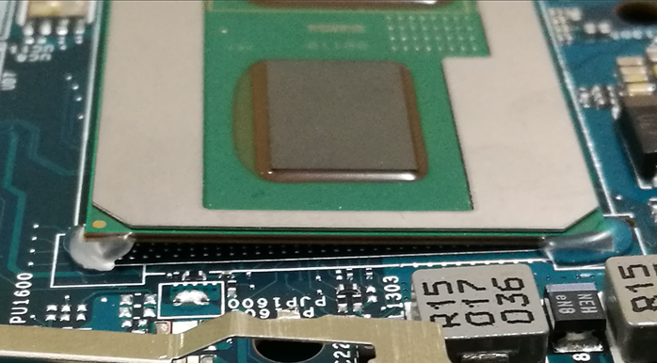
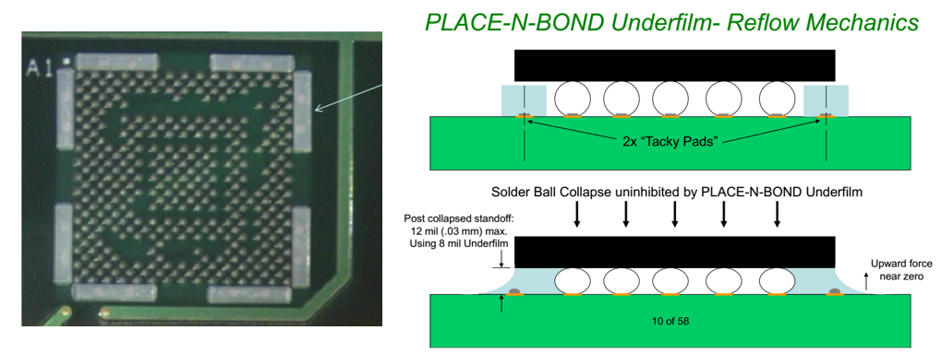
Adhesive on Intel BGA
Corner Dot (Big or Small) Adhesive
Corner “L-Shaped” Adhesive
3 Dots
1 Dot
Pre-SMT Underfilm - Concept

Slide 26
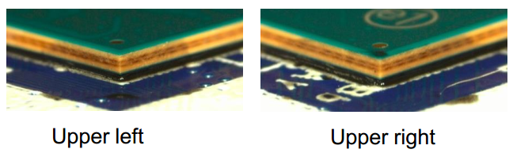
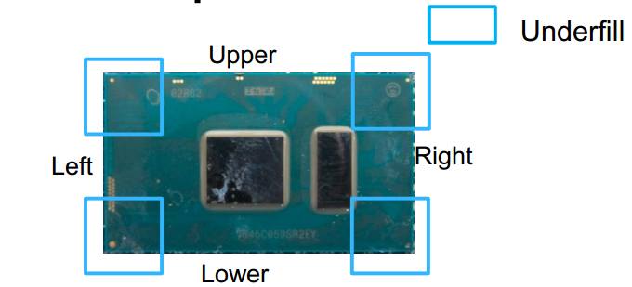
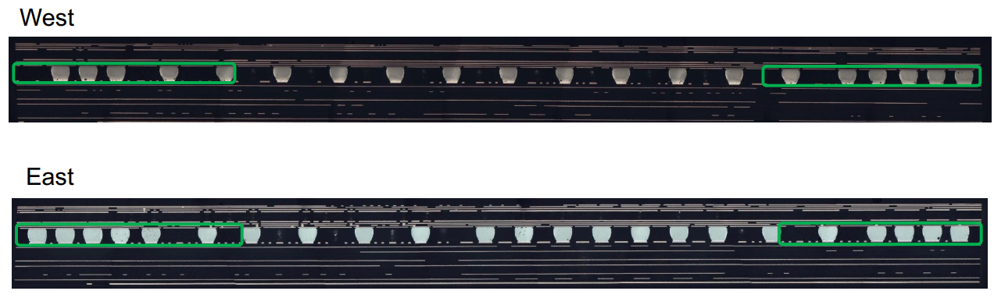
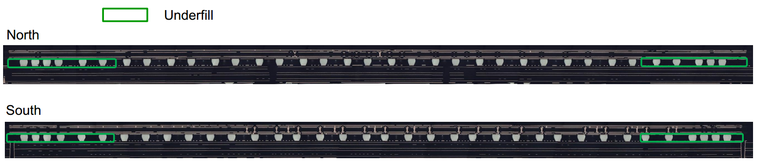
Adhesive on Intel BGA
Corner Underfill (Lenovo Confidential)

Slide 27
Adhesive on Intel BGA (Focused on Laptop & 2-in-1 Manufacturing)
Customer | Y/N | Adhesive shape/location | Vendor name/Model# | Where applied in Factory | Rework-able? | On/Off line
Inventec CQ | Yes | Corner ‘L’ | Loctite 3619 | Before FT | Yes | On line
Quanta CQ | Yes | Corner ‘L’ | Loctite 3619 | Before FT | Yes | On line
Quanta SH | Yes | Corner ‘L’ | Loctite 3619, EICT (UV) | Before ICT | Yes | On line
Compal CQ | Yes | Corner ‘L’ | U-BOND UB-4305 (UV) | Before ICT | Yes | On line
Compal KS | Yes | Corner ‘L’, Corner Underfill (Lenovo) | Corner ‘L’: Loctite 3705 (UV) C Underfill: Likely Loctite 3910 | Corner ‘L’: Before FT C Underfill: After ICT | Yes Hard | On line
Wistron KS | Yes | Corner Dot, Corner Underfill (Lenovo) | Corner Dot:Panasonic ADE480D-1 C Underfill: ASEC-AS3910 | Corner Dot:Before SMT C Underfill: Before FT | Yes Hard | On line
LCFC | Yes | 100% Corner Underfill (Lenovo) | C Underfill: ASEC, COOTEK, TaiLiDe | After FT | Yes Hard | On line
Pegatron SZ | Yes | Corner ‘L’ | 視域:UV649/信友:3329/DYMAX 9-20558/Loctite 3705 (All UV) | Before FT | Yes | On line
MSFT/JDM1 | No
MSI KS | Yes | Corner ‘L’ | ZhongYu ZY-303 (UV) | Before ICT | Yes | On line
Pegatron CQ | Yes | Corner ‘L’ | Xin You UV3329 (UV) | Before FT | Yes | On line
Foxconn WH | Yes | Corner Glue | Loctite 3705 (UV) | After SMT | Yes | On line
Samsung* | Yes | Underfilm | Unknown. Placed by PnP machine onto bd pads. | Before SMT | Unknown | On line
Note: Apple uses Dynamics 26663. Microsoft uses Zymet UA2605.
All major customers applying adhesive on Intel BGA except MSFT (adhesive decision is based on the reliability test results-to prevent SJ cracks)
All major customers are applying adhesive after SMT but before FT test (to prevent SJ crack during FT test), except with the underfill process (it is hard to rework)
Lenovo’s corner underfill covers a minimum of 5 solderballs in all 4 corners
UV glue is more popular than thermal glue, due to less factory floor space & easy to cure
*We know Samsung uses underfilm but the CMEE team did not visit them
Top DT customers (Gigabyte & MSI) seldom add adhesive on Intel PCH (one exception: Asustek)

Slide 28
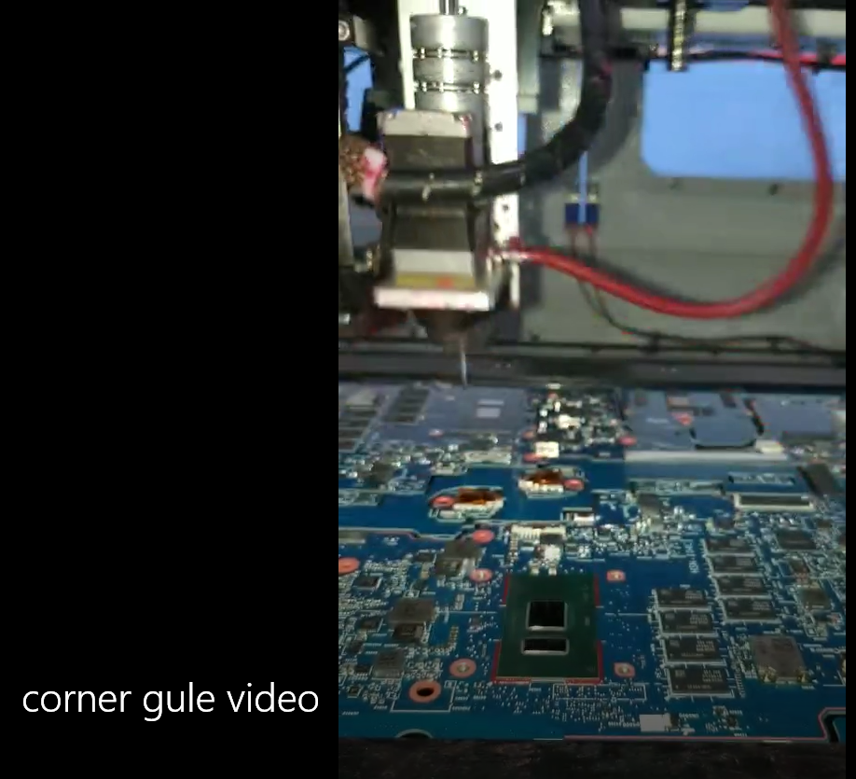
Corner Glue Video (HVM Factory)

Slide 29
Key Mobile/Client Industry Enabling Projects for 2018 and Beyond
Stencil Area Ratio (A/R) Extensions
Provide solutions to help customers extend stencil A/R from 0.66 down to 0.55 by TGL timeframe (for additional SBB / package warpage margin)
Board Thickness Reduction
Reduce the board thickness envelope to include 0.6mm, for ICL-Y series and beyond
Provide MAS solutions for monitoring & controlling board warpage
Work with key PCB manufacturer’s to ensure they are also monitoring & controlling warpage
LTS Adoption
Provide mfg & process solutions to enable industry LTS adoption, esp. by ADL if LTS becomes a rqmt.
Board Level Adhesive Solutions
A robust & validated adhesive process is key to ensuring LTS & thin board reliability success

Slide 30
BACKUP

Slide 31
Adhesive on Intel BGA
Additional Adhesive Info per Jagadeesh
I had looked at teardowns of Intel and non-Intel based tablets (back when we were still focused on Tablets). At that time, I noticed that all SoCs (Intel and non-Intel) had corner glue or underfill. So, I would safely say adhesives are common in laptop / 2-in-1 / tablets / cellphones (cell phones tend to have full underfill), and adhesives are less prevalent in DT and servers.
Additional Adhesive Info per SA Moy
For tablets, I think it is much more sensitive on mobility (drop test performance). Moreover, if our future is also focusing on LTS process, solder joint protection with using adhesive is key. In this case, we also need to remind package platform guys that to consider keep out zone for adhesive (corner glue). FYI…. During LTS sharing, a customer even asking us what type of adhesive that Intel recommended.

